Slide 1
Embedded Systems Cybersecurity Week 11
Mr. Mark Roman
romanmj@rowan.edu
570.956.4418

Slide 2
Topics for Today
Questions about Virtual Machines, Kali, Wireshark, SQL, Etc.
Defensive Measures

Slide 3
Current Events/Special Content
Student Finds Hidden Devices in the College Library - Are they nefarious?
https://youtu.be/UeAKTjx_eKA
New attacks on graphics processors endanger user privacy
https://news.ucr.edu/articles/2018/11/05/new-attacks-graphics-processors-endanger-user-privacy
How Do You Get Students to Think Like Criminals?
https://www.nytimes.com/2018/11/14/opinion/cybersecurity-education-skills.html
Two VM Escape flaws found in VMWare VMXNet3 Adapters
https://www.gdwnet.com/2018/11/15/two-flaws-found-in-vmxnet3-adapters/

Slide 4
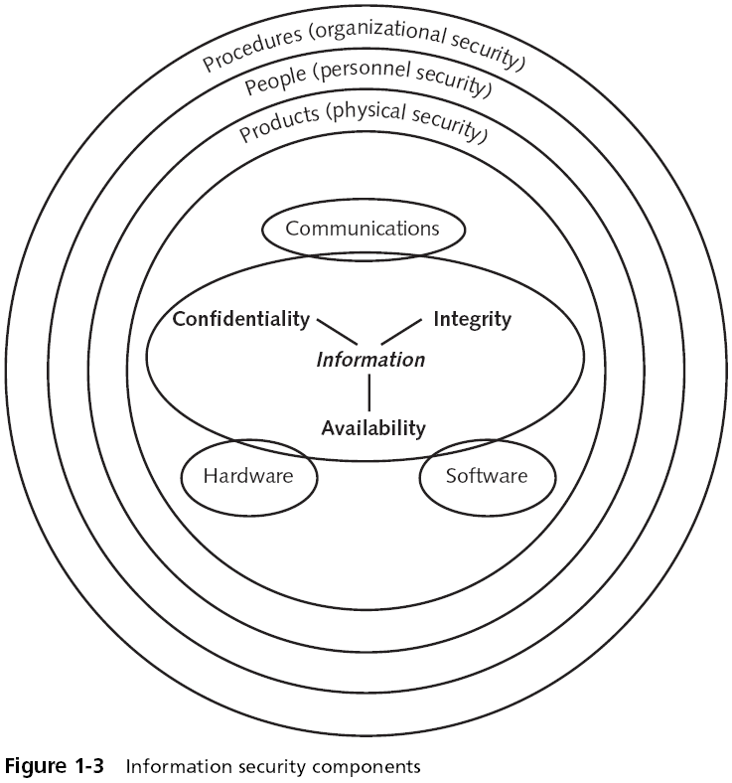
Cybersecurity Concepts

Slide 5
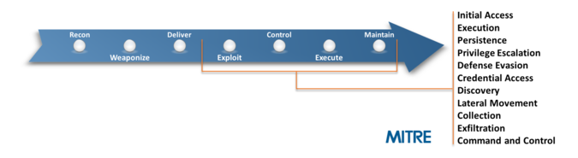
Exploitation

Slide 6
Defense IN Depth
The concept of protecting an physical or digital asset (data) with a series of defensive layers so that if one layers fails, another layer will already be in place to thwart an attack.
Example:
We start with our data, then we encrypt it to protect it:
The data is stored on a device
The data has file permissions
The data is encrypted
The data is in a secure area of the building
There is a security guard at the building entrance checking identification
There is CCTV on the perimeter
There is a high fence on the perimeter
Therefore, before someone can steal the data, they have seven layers of security that they must pass through. The concept of defense in depth is that if one layer fails, then the next layer protects:

Slide 7
Defenses - Network
Intrusion Detection Systems
An intrusion detection system (IDS) is a device or software application that monitors a network or systems for malicious activity or policy violations. Any malicious activity or violation is typically reported either to an administrator or collected centrally using a security information and event management (SIEM) system. A SIEM system combines outputs from multiple sources, and uses alarm filtering techniques to distinguish malicious activity from false alarms.
IDS types range in scope from single computers to large networks. The most common classifications are network intrusion detection systems (NIDS) and host-based intrusion detection systems (HIDS). A system that monitors important operating system files is an example of an HIDS, while a system that analyzes incoming network traffic is an example of an NIDS. It is also possible to classify IDS by detection approach: the most well-known variants are signature-based detection (recognizing bad patterns, such as malware); and anomaly-based detection (detecting deviations from a model of "good" traffic, which often relies on machine learning). Some IDS products have the ability to respond to detected intrusions. Systems with response capabilities are typically referred to as an intrusion prevention system

Slide 8
Defenses - Network
Network Intrusion Detection Systems - NIDS
Network IDSs (NIDSs) are placed in key areas of network infrastructure and monitor traffic as it flows to other hosts. Network based IDS has grown in popularity and outpaced the acceptance of HIDS. A NIDS is more cost effective than an HIDS because it can protect a large swath of network infrastructure with one device. With NIDS, the intrusion analyst has a wide-angle view of what is happening in and around the network. Monitoring for specific hosts or attackers can be increased or decreased with relative ease.
A NIDS can be more secure and less prone to outages than an HIDS. The NIDS should be run on a single hardened host that supports only services related to intrusion detection, making it more difficult to disable. NIDSs lose the disadvantages of relying on the integrity and availability of the monitored host, and are subsequently less prone to unobserved outages.
By not relying on the security of the host, NIDSs are not as prone to evidence destruction as HIDSs. Because NIDSs capture data and store it on a different machine, an attacker cannot easily remove the evidence of an attack.
NIDSs do have some disadvantages inherent in their design. NIDSs must be extraordinarily proficient at sucking up large amounts of network traffic to remain effective. As network traffic increases exponentially over time, the NIDS must be able to grab all this traffic and interpret it in a timely manner. Currently, NIDSs must be carefully placed and tuned to avoid situations where packet loss can occur. This can often require placing several NIDSs downstream from a core router or switch.
NIDSs are also vulnerable to IDS evasion techniques. Hackers have discovered numerous methods for hiding malicious traffic in ways an NIDS cannot detect.

Slide 9
Defenses - Network
Host Intrusion Detection Systems - HIDS
HIDSs are in tune with the host they reside upon. They have deep knowledge that is available only to an IDS that actually resides on the same computer that is being monitored. Therefore, HIDSs can have specific knowledge about the host and the type of activity that is normal for it. Traffic sent to the host might appear perfectly normal to a NIDS, but be recognized by the HIDS as abnormal and malicious. For this reason, HIDSs can discover attacks that a NIDS would not be able to.
Host-based IDSs do have some significant disadvantages. Because they reside on the monitored host, they have a limited view of the entire network topology. HIDSs cannot detect an attack that is targeted for a host that doesn't have an HIDS installed. An attacker can compromise a machine that lacks an HIDS and then use legitimate access to a protected machine, and the HIDS would be none the wiser. To monitor for intrusion attempts, the HIDS has to be placed on every critical host. This becomes cost prohibitive as the number of hosts critical to the organization grows. Running IDSs at the host level also means that you need to have an HIDS version available for every operating system you need to protect. If you have obscure versions of operating systems at your organization or run legacy systems, you may not be able to provide the coverage even if your organization can afford it.
HIDSs that rely on audit logs and error messages are essentially detecting attacks after they have occurred, which can lead to all sorts of problems. Some attacks can compromise the host before data is written to a log, effectively disabling the HIDS. HIDSs rely on the host to facilitate communication to the intrusion analyst; therefore any attack that can disable the host outright goes unnoticed.

Slide 10
Defenses - Network
Host Intrusion Detection Systems - HIDS
HIDSs are in tune with the host they reside upon. They have deep knowledge that is available only to an IDS that actually resides on the same computer that is being monitored. Therefore, HIDSs can have specific knowledge about the host and the type of activity that is normal for it. Traffic sent to the host might appear perfectly normal to a NIDS, but be recognized by the HIDS as abnormal and malicious. For this reason, HIDSs can discover attacks that a NIDS would not be able to.
Host-based IDSs do have some significant disadvantages. Because they reside on the monitored host, they have a limited view of the entire network topology. HIDSs cannot detect an attack that is targeted for a host that doesn't have an HIDS installed. An attacker can compromise a machine that lacks an HIDS and then use legitimate access to a protected machine, and the HIDS would be none the wiser. To monitor for intrusion attempts, the HIDS has to be placed on every critical host. This becomes cost prohibitive as the number of hosts critical to the organization grows. Running IDSs at the host level also means that you need to have an HIDS version available for every operating system you need to protect. If you have obscure versions of operating systems at your organization or run legacy systems, you may not be able to provide the coverage even if your organization can afford it.
HIDSs that rely on audit logs and error messages are essentially detecting attacks after they have occurred, which can lead to all sorts of problems. Some attacks can compromise the host before data is written to a log, effectively disabling the HIDS. HIDSs rely on the host to facilitate communication to the intrusion analyst; therefore any attack that can disable the host outright goes unnoticed.

Slide 11
NIDS/HIDS Detection Mechanisms
Signature-Based
Signature-based IDS refers to the detection of attacks by looking for specific patterns, such as byte sequences in network traffic, or known malicious instruction sequences used by malware. This terminology originates from anti-virus software, which refers to these detected patterns as signatures. Although signature-based IDS can easily detect known attacks, it is difficult to detect new attacks, for which no pattern is available.
Anomaly-Based
Anomaly-based intrusion detection systems were primarily introduced to detect unknown attacks, in part due to the rapid development of malware. The basic approach is to use machine learning to create a model of trustworthy activity, and then compare new behavior against this model. Although this approach enables the detection of previously unknown attacks, it may suffer from false positives: previously unknown legitimate activity may also be classified as malicious. Most of the existing IDSs suffer from the time-consuming during detection process that degrades the performance of IDSs. Efficient feature selection algorithm makes the classification process used in detection more reliable.
Behavior-Based
New types of what could be called anomaly-based intrusion detection systems are being viewed by Gartner as User and Entity Behavior Analytics (UEBA) (an evolution of the user behavior analytics category) and network traffic analysis (NTA). In particular, NTA deals with malicious insiders as well as targeted external attacks that have compromised a user machine or account. Gartner has noted that some organizations have opted for NTA over more traditional IDS.

Slide 12
Common Examples of HIDS/NIDS
HIDS
OSSEC - (Open Source HIDS SECurity) is a free, open-source host-based intrusion detection system (HIDS). It performs log analysis, integrity checking, Windows registry monitoring, rootkit detection, time-based alerting, and active response. It provides intrusion detection for most operating systems, including Linux, OpenBSD, FreeBSD, OS X, Solaris and Windows. OSSEC has a centralized, cross-platform architecture allowing multiple systems to be easily monitored and managed. OSSEC has a log analysis engine that is able to correlate and analyze logs from multiple devices and formats.
Samhain - Integrity checker and host intrusion detection system that can be used on single hosts as well as large, UNIX-based networks. It supports central monitoring as well as powerful (and new) stealth features to run undetected in memory, using steganography.

Slide 13

Common Examples of HIDS/NIDS
NIDS
Zeek - (formerly Bro) is a free and open-source software network analysis framework; it was originally developed in 1994 by Vern Paxson and was named in reference to George Orwell's Big Brother from his novel Nineteen Eighty-Four. It can be used as a network intrusion detection system (NIDS) but with additional live analysis of network events. It is released under the BSD license.
Snort - Snort is a free open source network intrusion detection system (IDS) and intrusion prevention system (IPS) created in 1998 by Martin Roesch, former founder and CTO of Sourcefire. Snort is now developed by Cisco, which purchased Sourcefire in 2013, at which Roesch is a chief security architect.

Slide 14
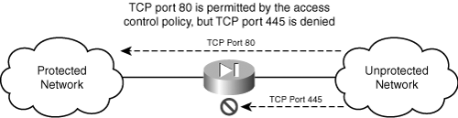
Firewalls
Firewalls can:
Manage and control network traffic
Authenticate access (kinda)
Act as an intermediary
Protect resources
Record and report on events (at a perimeter)
DENY BY DEFAULT

Slide 15
Firewalls
Firewalls can’t:
Protect from insider attacks.
Prevent malicious traffic inside the perimeter of a network the firewall is protecting.
Protect against removable media threats.
Protect against bad configuration or poor security management.

Slide 16
Firewalls
Packet Filtering Firewall
Packet Filtering Firewalls are normally Deployed on the Routers which connect the Internal Network to Internet. Packet Filtering Firewalls can only be Implemented on the Network Layer of OSI Model.
Packet Filtering Firewalls work on the Basis of Rules defines by Access Control Lists. They check all the Packets and screen them against the rules defined by the Network Administrator as per the ACLs. If in case, any packet does not meet the criteria then that packet is dropped and Logs are updated about this information.
Administrators can create their ACLs on the basis Address, Protocols and Packet attributes.
Advantage:
The Biggest Advantage of Packet Filtering Firewalls is Cost and Lower Resource Usage. Best Suited for Smaller Networks.
Disadvantage:
Packet Filtering Firewalls can work only on the Network Layer and these Firewalls do not support Complex rule based models. Also Vulnerable to Spoofing in some Cases.

Slide 17
Firewalls
Circuit Level Gateway Firewalls
Circuit level gateways are deployed at the Session layer of the OSI model and they monitor sessions like TCP three way handshake to see whether a requested connection is legitimate or not.
Major Screening happens before the Connection is Established.
Information sent to a Computer outside the network through a circuit level gateway appears to have originated from the Gateway. This helps in creating a stealth cover for the private network from outsiders.
Advantage:
Circuit level gateways are comparatively inexpensive and provide Anonymity to the private network.
Disadvantage:
Circuit level Gateways do not filter Individual Packets. After Establishing a Connection, an Attacker may take advantage of this.

Slide 18
Firewalls
Application level Gateway Firewalls
Application level gateways work on the Application layer of the OSI model and provide protection for a specific Application Layer Protocol. Proxy server is the best example of Application Level Gateways Firewalls.
Application level gateway would work only for the protocols which is configured. For example, if we install a web proxy based Firewall than it will only allow HTTP Protocol Data. They are supposed to understand application specific commands such as HTTP:GET and HTTP:POST as they are deployed on the Application Layer, for a Specific Protocol.
Application level firewalls can also be configured as Caching Servers which in turn increase the network performance and makes it easier to log traffic.

Slide 19
Firewalls
Stateful Multilayer Inspection Firewall
Stateful multilayer Inspection Firewall is a combination of all the firewalls that we have studied till now.
They can Filter packets at Network layer using ACLs, check for legitimate sessions on the Session Layers and they also evaluate packets on the Application layer (ALG).
Stateful Multilayer Inspection Firewall can work on a Transparent mode allowing direct connections between the client and the server which was earlier not possible.
Stateful Multilayer Inspection firewall can also implement algorithms and complex security models which are protocol specific, making the connections and data transfer more secure.

Slide 20
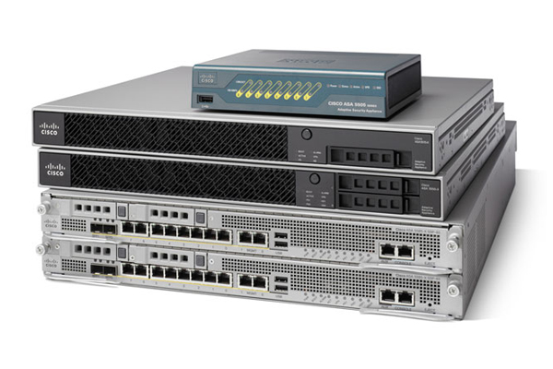
Firewalls
Common Firewalls
Fortinet
Cisco ASA
pfSense
FireEye

Slide 21
Firewalls IN Embedded Devices
Typically Host Based/Embedded OS Dependent
Typically IPTables – More Later
Solutions Emerging

Slide 22
Intrusion Prevention Systems
Intrusion-prevention system
There are two types of Intrusion-Prevention Systems (IPS), the first is the Network Intrusion Prevention System (NIPS), which can only operate on your network and cannot work inside a host. The second is called the Host Intrusion Prevention System (HIPS), and it operates inside a host machine and cannot operate on the network.
The IPS often sits directly behind the firewall and provides a complementary layer of analysis that negatively selects for dangerous content. Unlike its predecessor the Intrusion Detection System (IDS)—which is a passive system that scans traffic and reports back on threats—the IPS is placed inline (in the direct communication path between source and destination), actively analyzing and taking automated actions on all traffic flows that enter the network. Specifically, these actions include:
Sending an alarm to the administrator (as would be seen in an IDS)
Dropping the malicious packets
Blocking traffic from the source address
Resetting the connection
As an inline security component, the IPS must work efficiently to avoid degrading network performance. It must also work fast because exploits can happen in near real-time. The IPS must also detect and respond accurately, so as to eliminate threats and false positives (legitimate packets misread as threats).

Slide 23
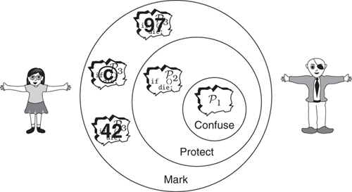
Defenses - Software
Surreptitious Software: Obfuscation, Watermarking, and Tamperproofing for Software Protection: Obfuscation, Watermarking, and Tamperproofing for Software Protection

Slide 24
Defenses - Software
Integrity Checking
Integrity verification is a simple but highly effective means of monitoring for intruders. It works by means of generating a checksum for every file on a system, and then periodically comparing that checksum to the original file to ensure a change has not occurred. If an unauthorized file change transpires, an alert is generated.
A large number of files on any system regularly change in the course of normal operation. The integrity verification IDS must be carefully tuned to avoid false positives. The checksums need to be reset when legitimate changes occur.
Integrity verification can be used to detect Web page defacements. Attackers often gain access to unpatched external facing Web servers and change the content the Web server displays.
Integrity verification has some limitations as well. The primary disadvantage with integrity verification technology is that it requires access to sensitive files on the monitored host. Additionally, it may be computationally intensive to verify checksums. Finally, on asset stored checksums could be compromised rendering the approach worthless.

Slide 25
Defenses - Software
Code Obfuscation
Obfuscation relies on transformation into a form that is more difficult for an adversary to understand or change than the original code. We are deliberately vague about defining “difficult,” but we typically take it to mean that the obfuscated program requires more human time, more money, or more computing power to analyze than the original program. Under this definition, to distribute a program in a compiled form rather than as source code is a form of obfuscation, since analyzing binary machine code is more demanding than reading source. Similarly, we would consider a program that has been optimized to be more obfuscated than one that has not, since many code optimizations make analysis (both by humans and tools such as disassemblers and decompilers) more onerous (a potential drawback).

Slide 26
Defenses - Software
Code Obfuscation (Artificial Diversity)
Randomized Code Distribution such that attacks may not propagate.
Abstraction transformations break down the overall structure of the program, i.e., they obfuscate the way the programmer has organized the program into classes, modules, and functions.
Data transformations replace the data structures the programmer has selected with others that reveal less information.
Control transformations modify the control structures (if- and while-statements) in the program to hide the paths it may take at runtime.
Dynamic transformations, finally, insert a transformer Obfuscating Transformations into the program so that, at runtime, Obfuscating Transformations causes the program to continuously transform itself.

Slide 27
Defenses - Software
Birthmarking
Physical Requirements (Tokens, etc.)
Encrypted Execution

Slide 28
Defenses - Software
Vulnerability Management (Patching)
Vulnerability management is the "cyclical practice of identifying, classifying, remediating, and mitigating vulnerabilities", particularly in software. Vulnerability management is integral to computer security and network security, and must not be confused with Vulnerability assessment.
Vulnerabilities can be discovered with a vulnerability scanner, which analyzes a computer system in search of known vulnerabilities, such as open ports, insecure software configurations, and susceptibility to malware infections. Unknown vulnerabilities, such as a zero-day, may be found with fuzz testing, which can identify certain kinds of vulnerabilities, such as a buffer overflow with relevant test cases. Such analysis can be facilitated by test automation. In addition, antivirus software capable of heuristic analysis may discover undocumented malware if it finds software behaving suspiciously (such as attempting to overwrite a system file).
Correcting vulnerabilities may variously involve the installation of a patch, a change in network security policy, reconfiguration of software, or educating users about social engineering.

Slide 29
Defenses - Logging/Audits
Application logs are invaluable data for:
Identifying security incidents
Monitoring policy violations
Establishing baselines
Assisting non-repudiation controls
Providing information about problems and unusual conditions
Contributing additional application-specific data for incident investigation which is lacking in other log sources
Helping defend against vulnerability identification and exploitation through attack detection
Application logging might also be used to record other types of events too such as:
Security events
Business process monitoring e.g. sales process abandonment, transactions, connections
Anti-automation monitoring
Audit trails e.g. data addition, modification and deletion, data exports
Performance monitoring e.g. data load time, page timeouts
Compliance monitoring
Data for subsequent requests for information e.g. data subject access, freedom of information, litigation, police and other regulatory investigations
Legally sanctioned interception of data e.g application-layer wire-tapping
Other business-specific requirements

Slide 30
Defenses - Logging/Audits
Sources:
Client software e.g. actions on desktop software and mobile devices in local logs or using messaging technologies, JavaScript exception handler via Ajax, web browser such as using Content Security Policy (CSP) reporting mechanism
Embedded instrumentation code
Network firewalls
Network and host intrusion detection systems (NIDS and HIDS)
Closely-related applications e.g. filters built into web server software, web server URL redirects/rewrites to scripted custom error pages and handlers
Application firewalls e.g. filters, guards, XML gateways, database firewalls, web application firewalls (WAFs)
Database applications e.g. automatic audit trails, trigger-based actions
Reputation monitoring services e.g. uptime or malware monitoring
Other applications e.g. fraud monitoring, CRM
Operating system e.g. mobile platform

Slide 31
Principle of Least Privilege
Principle of least privilege (PoLP, also known as the principle of minimal privilege or the principle of least authority) requires that in a particular abstraction layer of a computing environment, every module (such as a process, a user, or a program, depending on the subject) must be able to access only the information and resources that are necessary for its legitimate purpose.

Slide 32
Principle of Least Privilege
Removing Unnecessary Code/Libraries
Disabling Services
Disabling Unused Ports (Physical and Logical)
User accounts/roles as necessary
Data Management as Necessary
Debugging Obfuscation
Removal of production test points.

Slide 33
IPTables
Iptables Linux firewall is used to monitor incoming and outgoing traffic to another location and filter it based on user-defined rules to prevent anyone from accessing the system. Using Iptables you can define rules which will allow only selective traffic on your server. In this Iptables tutorial, you will learn how to secure your web application using Iptables.
Iptables Basics
All data is sent in the form packets over the internet. Linux kernel provides an interface to filter both incoming and outgoing traffic packets using tables of packet filters. Iptables is a command line application and a Linux firewall that you can use to set-up, maintain and inspect these tables. Multiple tables can be defined. Each table can contain multiple chains. A chain is nothing but a set of rules. Each rule defines what to do with the packet if it matches with that packet. When the packet is matched, it is given a TARGET. A target can be another chain to match with or one of the following special values:
ACCEPT: It means the packet will be allowed to pass through.
DROP: It means that packet will not be allowed to pass through.
RETURN: It means to skip the current chain and go back to the next rule from the chain it was called in.
For the scope of this iptables tutorial, we are going to work with one of the default tables called filter. Filters table has three chains ( sets of rules).
INPUT – This chain is used to control incoming packets to the server. You can block/allow connections based on port, protocol or source IP address.
FORWARD – This chain is used to filter packets that are incoming to the server but are to be forwarded somewhere else.
OUTPUT – This chain is used to filter packets that are going out from your server.

Slide 34
IPTABLES
Your turn…
Perform an NMAP scan of your metasploitable virtual machine (Save a screenshot).
Develop an set of iptables rules to block all but http (from any location) and ssh from some trusted IP.
Produce another NMAP scan, Save a screenshot, ensure you can still connect to metasploitable via SSH.
Produce your rule set in a final screenshot with iptables -L
man/Google is your friend here.

Slide 35
Resources
Tutorials
https://www.howtogeek.com/177621/the-beginners-guide-to-iptables-the-linux-firewall/
https://www.garron.me/en/linux/iptables-manual.html
Remember that you can always flush the table as well as re-download the virtual machine.

Slide 36
Rules of Engagement - Initial
Asset: Metasploitable Virtual Machine on a dedicated piece of hardware, connected physically to a router with a wireless LAN.
Blue Team:
Constraints: You must have an HTTP server running, ftp, and ssh and support operation of those functions.
Objectives:
Prevent Reconnaissance (There will be several points for obtaining fingerprint information)
Prevent Access to Ancillary Services (either by disabling/uninstalling or blocking with firewalls)
You must maintain situational awareness (detection of compromise)
Red Team:
Constraints: None
Objectives:
Obtain shell/root level access.
Deny situational awareness of the blue team.
Obstruct some service (Dos)
You already have a copy of the virtual machine, make sure you practice your commands in advance. You'll have 1 hour of prep. Red team will have the remaining time.

